Slide 1
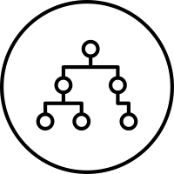
Design and Analysis of Algorithms
Lecture 3: Divide and Conquer

Slide 2
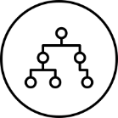
Principles of Divide and Conquer (1)
When the input size of a problem is small, one or two numbers for example, then this problem can be easily solved.
However, when the input size is large, many problems become difficult to solve.
Therefore, a basic methodology is to find the relationship between the solution for a large sized input and the solutions for small sized inputs.
Divide and Conquer is a particular approach that follows this methodology.

Slide 3
Principles of Divide and Conquer (2)
Principles of Divide and Conquer
Divide the problem with a large input size into a number of subproblems that are smaller instances of the same problem.
Conquer the subproblems by solving them recursively. If the size of a subproblem is small enough, then solve it in a straightforward manner which is called “bottom out.”
Combine the solutions to the subproblems into the solution for the original problem.

Slide 4
Binary Search – Example (1)
Suppose we have a sorted array of n numbers, A[1] ≤ A[2] ≤ … ≤ A[n].
Now, we need to design an algorithm that searches the array to see if this array contains a particular number x.
If A[i] = x, then report index I, otherwise report nil.
The following algorithm called binary search uses the divide and conquer approach.
Note that a smaller subproblem corresponds to a segment of the array A, denoted by A[p], A[p+1], …, A[r], where 1 ≤ p ≤ r ≤ n. This notation allows us to represent any subproblem.
When, p = 1, r = n, this sequence represents the original problem.

Slide 5
Binary Search – Example (2)
first
middle
last
33
0 | 1 | 2 | 3 | 4 | 5 | 6 | 7 | 8
3 | 12 | 21 | 33 | 44 | 64 | 70 | 88 | 90
Input: A[p], A[p+1], …, A[r], x
Output: i if A[i] = x, else nil.
BinarySearch (A, p, r, x);
1. if p > r
2. then return (nil)
3. midpoint ← ⎣(p+r)/2⎦
4. if A[midpoint] = x
5. then return (midpoint)
6. else if x < A[midpoint]
7. then BinarySearch (A, p, midpoint-1, x)
8. else BinarySearch (A, midpoint+1, r, x)
9. End
first
middle
last
0 | 1 | 2 | 3 | 4 | 5 | 6 | 7 | 8
3 | 12 | 21 | 33 | 44 | 64 | 70 | 88 | 90
first, middle
last
0 | 1 | 2 | 3 | 4 | 5 | 6 | 7 | 8
3 | 12 | 21 | 33 | 44 | 64 | 70 | 88 | 90
first, middle, last
0 | 1 | 2 | 3 | 4 | 5 | 6 | 7 | 8
3 | 12 | 21 | 33 | 44 | 64 | 70 | 88 | 90

Slide 6

Task
Write T(n) and O(n) expressions for the Binary Search algorithm
Input: A[p], A[p+1], …, A[r], x
Output: i if A[i] = x, else nil.
BinarySearch (A, p, r, x);
1. if p > r
2. then return (nil)
3. midpoint ← ⎣(p+r)/2⎦
4. if A[midpoint] = x
5. then return (midpoint)
6. else if x < A[midpoint]
7. then BinarySearch (A, p, midpoint-1, x)
8. else BinarySearch (A, midpoint+1, r, x)
9. End
(n)

Slide 7
Solution
T(0)=0
T(n) = 1+T(n/2)
T(n)=1+1+T(n/4)
…
Therefore T(n) = log n + 1
T(n)
T(n/2)
T(n/2)
Log n
T(n/4)
T(n/4)
T(n/4)
T(n/4)
(n)

Slide 8
Task
Write an algorithm that calculates min and max in an array. The algorithm should use divide and conquer approach
(n)

Slide 9
Solution
0 | 1 | 2 | 3 | 4 | 5 | 6 | 7
64 | 21 | 33 | 70 | 12 | 85 | 44 | 3
Max-Min (A[p.. r], Max, Min) //Assume r≥ p
if p = r
then { Max = A[p]
Min = A[p]
exit
}
endif
q ← ⎣(p+r)/2⎦
Max-Min (A[p.. q], Max1, Min1)
Max-Min (A[q+1, r], Max2, Min2)
Max = Max{ Max1, Max2}
Min = Min{ Min1, Min2}
End
64 | 21 | 33 | 70 | 12 | 85 | 44 | 3
64 | 21 | 33 | 70 | 12 | 85 | 44 | 3
min1=max1 64
min2=max2 21
min2=max1 33
min2=max2=70
min1=max1=12
min2=max2=85
min1=max1=44
min2=max2=3
min1 21 | max164
min1 12 | max1 85
min2 33 | max270
min23 | max2 44
min1 21 | max1 70
min2 3 | max2 85
(n)
min 3 | max 85

Slide 10
Task
Write T(n) and O(n) expressions for the Max-Min algorithm
Max-Min (A[p.. r], Max, Min) //Assume r≥ p
if p = r
then { Max = A[p]
Min = A[p]
exit
}
endif
q ← ⎣(p+r)/2⎦
Max-Min (A[p.. q], Max1, Min1)
Max-Min (A[q+1, r], Max2, Min2)
Max = Max{ Max1, Max2}
Min = Min{ Min1, Min2}
End
(n)

Slide 11
Solution
T(0)=0
T(1)=1
T(n) = 2+2T(n/2)
T(n)=2+2(2+2T(n/4))…
T(n) = 6+ 4(n/4)
T(n)=n+2(n-1)=3n-2
2
T(n)
2
2
T(n/2)
T(n/2)
T(n/4)
T(n/4)
T(n/4)
T(n/4)
(n)

Slide 12
Recurrence Relations (1)
Given a Divide and Conquer algorithm, how can we analyze its complexity? Usually, we first establish a recurrence relation that reflects the recursion of the algorithm.
Then the complexity is obtained by solving this recurrence relation.
For example, we can analyze the Binary search in this way: We count the number of comparisons between the array A and the number x. Let T(n) be the number of such comparisons needed by the algorithm in the worst case.
Then we have the following recurrence relation.
T(0) = 0
T(n) = T(⎣n/2⎦) + 1

Slide 13
Recurrence Relations (2)
This is because when the sequence is empty, we need no comparison. When the sequence is not empty, we need one comparison between x and the median. If they are equal then algorithm stops.
However, in the worst case, they are not equal. So the recursion will continue to search in either the first part or the second part that contains ⎣n/2⎦ numbers in the worst case.
For other divide and conquer algorithms, their complexity can be similarly obtained. Suppose an algorithm first divides an input with size n into b (>1) subproblems with size n/b each. Then, it conquers a subproblems out of the b subproblems.

Slide 14
Recurrence Relations (3)
Finally, it combine the solutions from the a solutions into a solution for the original problem, which needs time f(n). Then, the complexity T(n) of this algorithm can be represented by the following recurrence relation：
T(n) = aT(n/b) + f(n)
T(1) = Θ(1)
where T(1) = Θ(1) means that the bottom case needs a constant time. Note that the size for the bottom case may be 0, may be 1, may be 2, etc. therefore, we may have T(0) = Θ(1), T(1) = Θ(1), T(2) = Θ(1), T(3) = Θ(1), etc.
However, we will see that the size of the bottom case does not affect the asymptotic complexity of the algorithm.

Slide 15
Basic Log Rules
1) log_{b}b=1
2) log_{b}(mn) = log_{b}(m) + log_{b}(n)
3) log_{b}(^{m}/_{n}) = log_{b}(m) – log_{b}(n)
4) log_{b}(m^{n}) = n · log_{b}(m)
5) log_{b}(b^{m})=m
We refer to log₂ as log or lg

Slide 16
Example
The Substitution Method
Solve the following recurrence problem
T(n) = 2T(⎣n/2⎦) + n.
Solution
We guess T(n)<=O(n log n)
We assume that this bound holds for all positive m<n yielding: T(n/2)<=c⎣n/2⎦ lg (⎣n/2⎦)
T(n) = 2T(⎣n/2⎦) + n
≤ 2(c⎣n/2⎦ lg (⎣n/2⎦)) + n
≤ 2(cn/2)lg (n/2) + n
≤ cnlg (n/2) + n
≤ cn(lg n -1) + n
= cn lgn –cn + n
≤ cn lgn (if c ≥ 1)
(n)

Slide 17
Task
Write the recurrence relation for binary tree traversal.
Solve it with the recursion tree.

Slide 18
Solution
T(n)
1
T(n/2)
T(n/2)
2
T(n/4)
T(n/4)
T(n/4)
T(n/4)
4
...
The cost here corresponds to the number of nodes in the tree, which is n in this case.

Slide 19
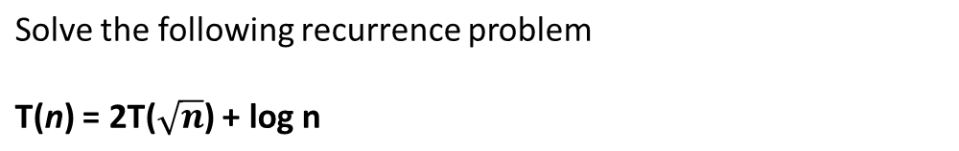
Task
using the substitution method
(n)

Slide 20
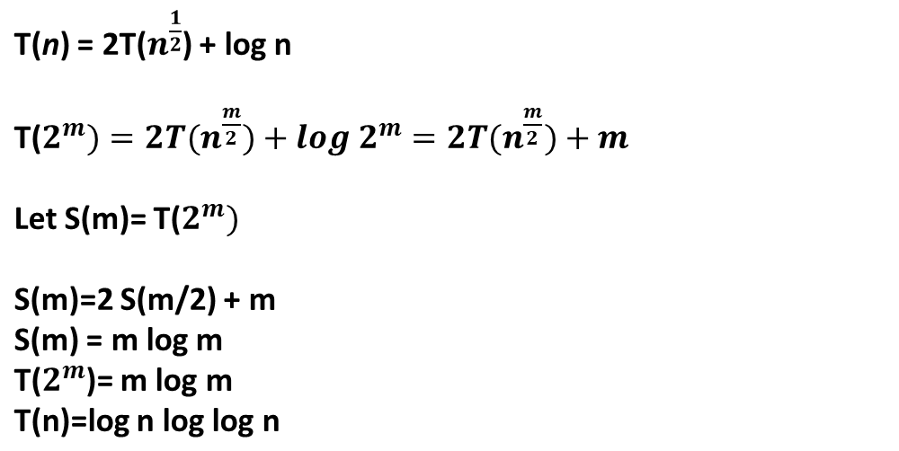
Solution
2
2
T(2^m) = 2T(2^m/2)+m
S(m)=T(2^m)
S(m)=2(m/2)+m
S(m)=m log m

Slide 21






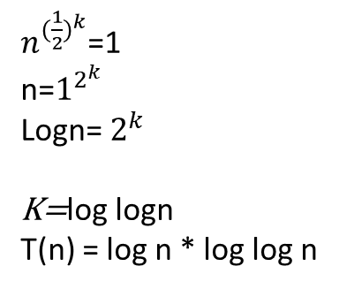

Solution
T(n)

Slide 22
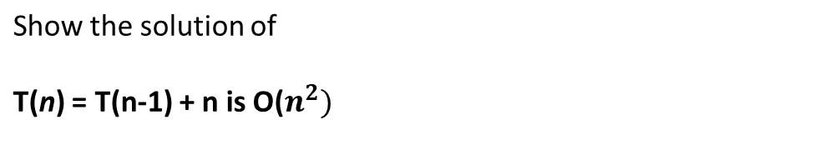
Task
(n)

Slide 23
Solution
The Summation Method
Show the solution of
T(n) = T(n-1) + n
T(n)= T(n-2)+n-1+n
T(n)=T(n-3)+n-2+n-1+n
T(n)=T(n-4)+n-3+n-2+n-1+n
T(n) =T(0)+1+2+…+n-1+n
T(n)=n(n+1)/2 = O(n^2)
(n)

Slide 24
Task
Solve T(n) = 2T(n/2) + nlgn
(n)

Slide 25
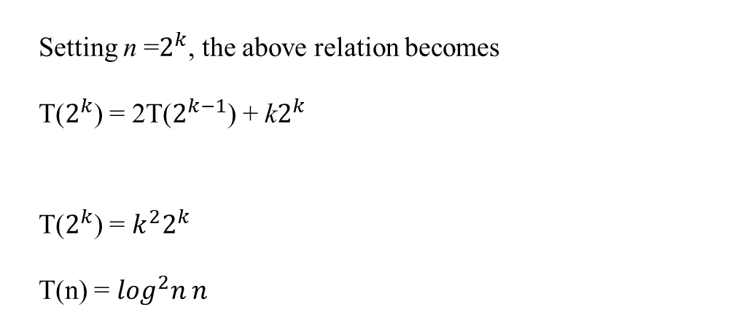
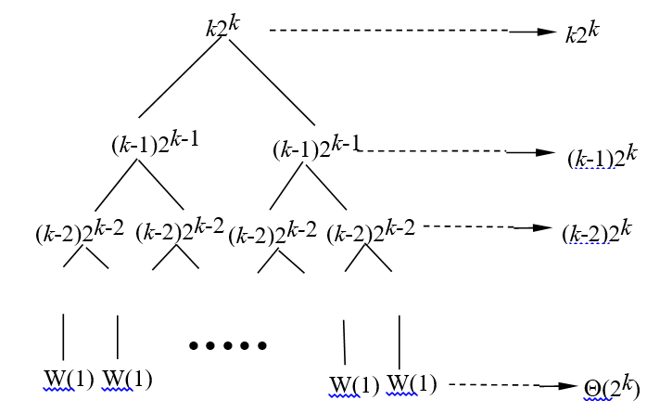
Task
Solve T(n) = 2T(n/2) + n log n
(n)

Slide 26
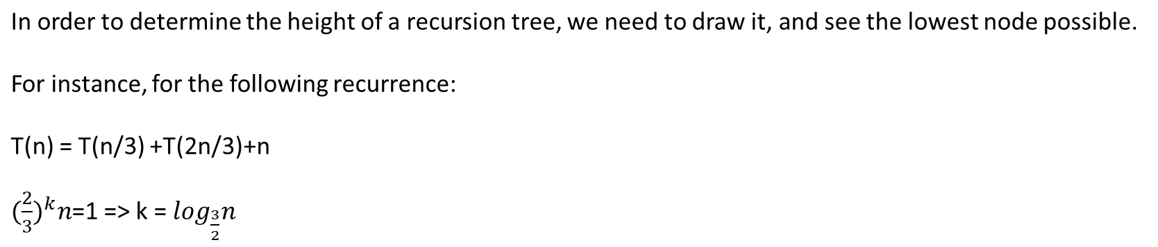
Determining the Height of Recursion Trees

Slide 27
Task
Determine the height of the recursion tree of the following recurrence:
T(n) = 4T(n/4) + n

Slide 28
Task
Determine the height of the recursion tree of the following recurrence:

Slide 29
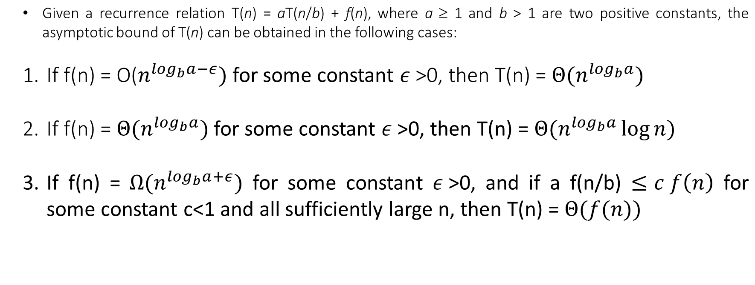
The Master Algorithm
(n)

Slide 30
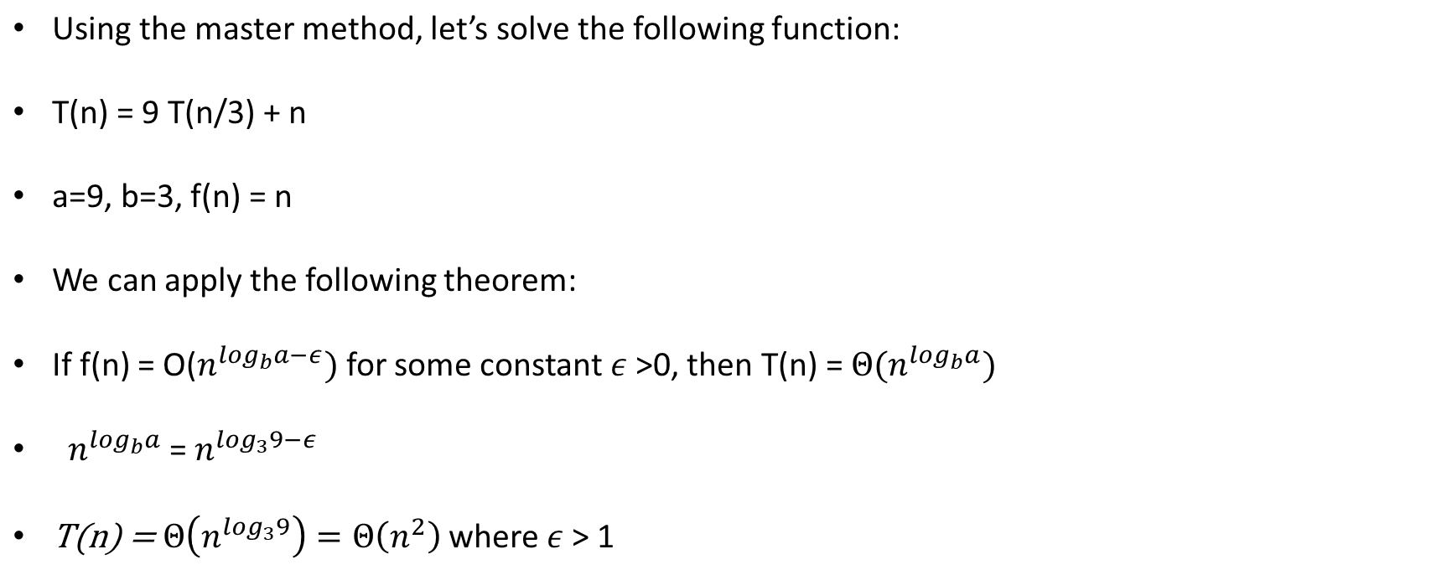
Example
=
(n)

Slide 31
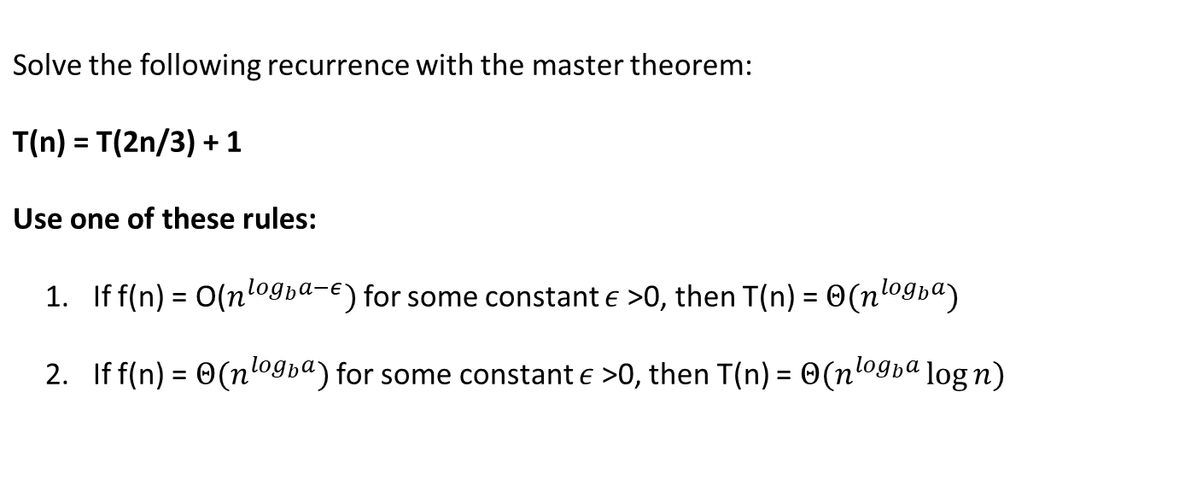
Task
(n)

Slide 32
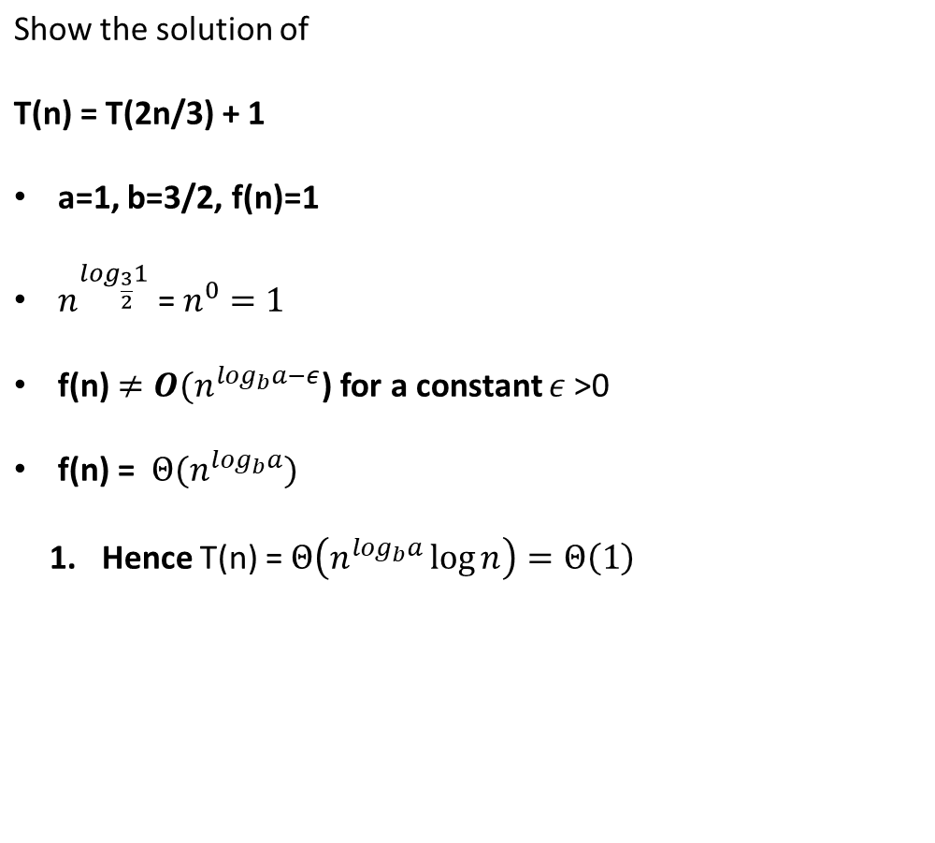

Solution
(n)

Slide 33
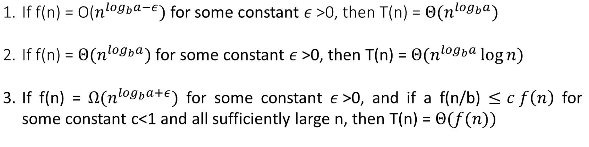
Task
Solve the following recurrence:
T(n) = 3T(n/4) + nlgn
Using one of the following theorems:
(n)

Slide 34
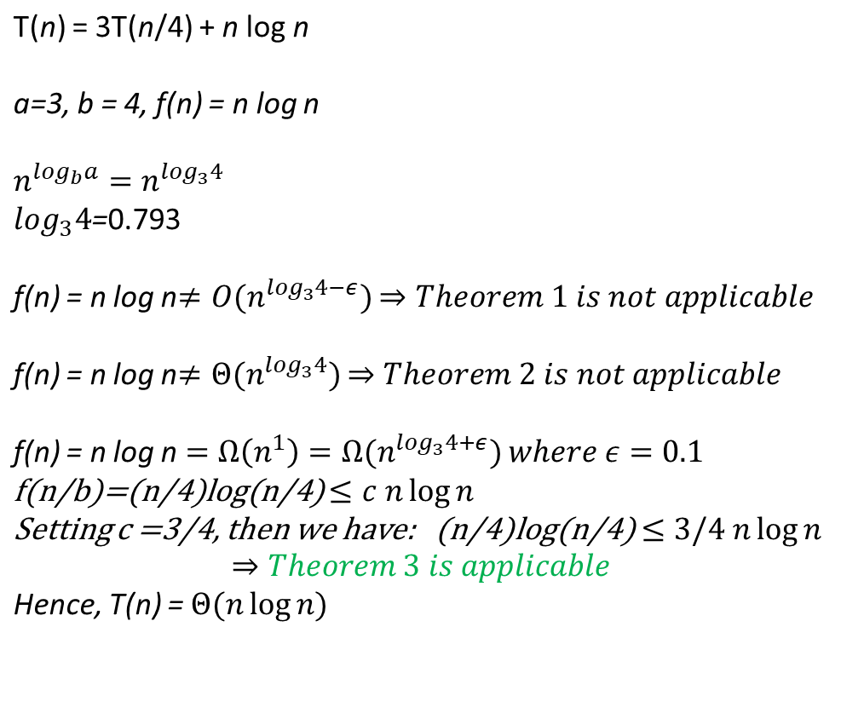





Solution
n
n
n
(n)

Slide 35
Task
Solve the following recurrence:
T(n) = 2T(n/2) + n
Using one of the following theorems:
(n)

Slide 36
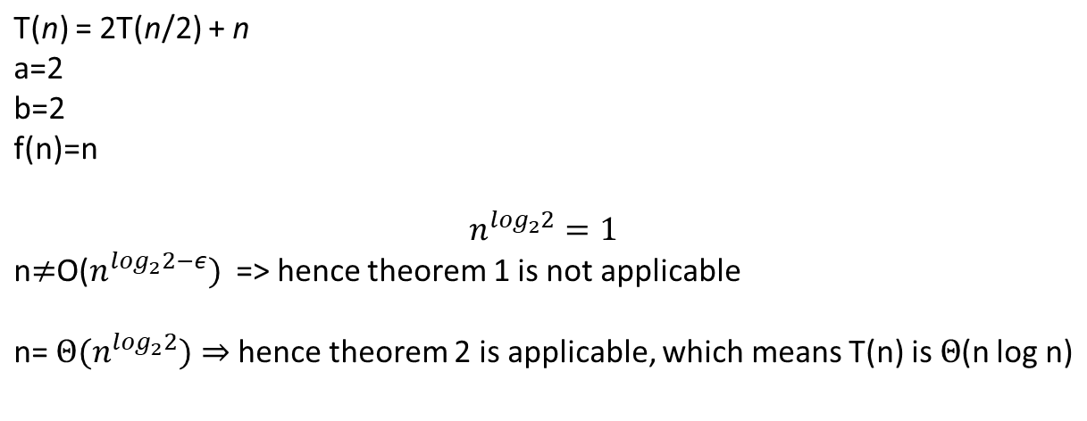
Solution
(n)

Slide 37
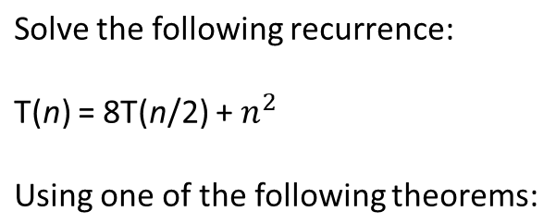
Task
(n)

Slide 38
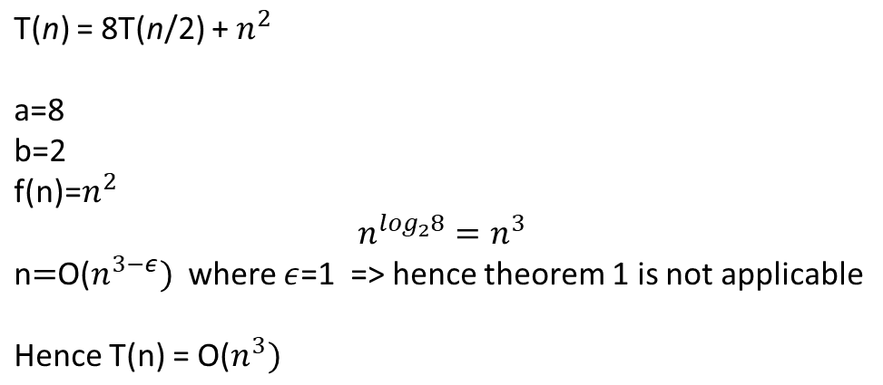
Solution
(n)

